Slide 1
Data Structures & Algorithms SECP2043

Slide 2
Pointer Variables
A variable whose content is an address (that is, a memory address).
dataType *identifier;
As an example, consider the following statements:
int *p;
char *ch;

Slide 3
Address of Operator (&)
&: called the “address of operator”
Example
int x;
int *p;
p = &x;

Slide 4
Dereferencing Operator (*)
* refers to the object to which the operand points
Example:
int x = 25;
int *p;
p = &x;
cout << *p << endl;
*p = 55;

Slide 5
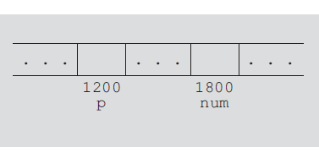
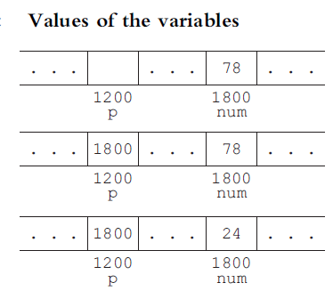
Example 3-1
int *p;
int num;
num = 78;
p = &num;
*p = 24;

Slide 6
Let us summarize the preceding discussion.
1. A declaration such as int *p; allocates memory for p only, not for *p. Later, you learn how to allocate memory for *p.
2. The content of p points only to a memory location of type int.
3. &p, p, and *p all have different meanings.
4. &p means the address of p—that is, 1200 (as shown in Figure 3-1).
5. p means the content of p, which is 1800, after the statement p = &num; executes.
6. *p means the content of the memory location to which p points. Note that the value of *p is 78 after the statement p = &num; executes; the value of *p is 24 after the statement *p = 24; executes.

Slide 7
Array-Based Lists
List consisting of employee data, student data, sales data, or a list of rental properties.
List: A collection of elements of the same type.
The length of a list is the number of elements in the list.

Slide 8
Operations performed on a list
1. Create the list. The list is initialized to an empty state.
2. Determine whether the list is empty.
3. Determine whether the list is full.
4. Find the size of the list.
5. Destroy, or clear, the list.
6. Determine whether an item is the same as a given list element.
7. Insert an item in the list at the specified location.
8. Remove an item from the list at the specified location.
9. Replace an item at the specified location with another item.
10. Retrieve an item from the list from the specified location.
11. Search the list for a given item.

Slide 9
List Implementation
To maintain and process three variables are required:
The array holding the list elements
A variable to store the length of the list
A variable to store the size of the array
If length indicates the number of elements in list and maxSize indicates maximum number of elements those can be accommodated.
Then both length and maxSize are non-negative integers, therefore type: int
Type of Array: based on data elements to be stored (int, double, string etc)
While designing the algorithms, we do not want to be concerned whether we are processing a list of numbers, a list of names, or a list of students’ data.

Slide 10
Array-based list implementation
template <class elemType>
class arrayListType
{
public:
const arrayListType<elemType>& operator=
(const arrayListType<elemType>&);
//Overloads the assignment operator

Slide 11
bool isEmpty() const;
//Function to determine whether the list is empty
//Postcondition: Returns true if the list is empty;
// otherwise, returns false.
bool isFull() const;
//Function to determine whether the list is full.
//Postcondition: Returns true if the list is full;
// otherwise, returns false.
int listSize() const;
//Function to determine the number of elements in the list
//Postcondition: Returns the value of length.

Slide 12
int maxListSize() const;
//Function to determine the size of the list.
//Postcondition: Returns the value of maxSize.
void print() const;
//Function to output the elements of the list
//Postcondition: Elements of the list are output on // the standard output device.
bool isItemAtEqual(int location, const elemType& item) const;
//Function to determine whether the item is the same
//as the item in the list at the position specified //by Postcondition: Returns true if list[location]
// is the same as the item; otherwise,
// returns false.

Slide 13
void insertAt(int location, const elemType& insertItem);
//Function to insert an item in the list at the
//position specified by location. The item to be //inserted is passed as a parameter to the function.
//Postcondition: Starting at location, the elements //of the list are shifted down,
//list[location] = insertItem;,
//and length++;. If the list is full or location is
//out of range, an appropriate message is displayed.
void insertEnd(const elemType& insertItem);
//Function to insert an item at the end of the list.
//The parameter insertItem specifies the item to be // inserted.
//Postcondition: list[length] = insertItem; and // length++; If the list is full, an appropriate //message is displayed.

Slide 14
void removeAt(int location);
//Function to remove the item from the list at the
//position specified by location
//Postcondition: The list element at list[location] is //removed and length is decremented by 1. If location is //out of range, an appropriate message is displayed.
void retrieveAt(int location, elemType& retItem) const;
//Function to retrieve the element from the list at the
//position specified by location.
//Postcondition: retItem = list[location]
//If location is out of range, an appropriate message is
// displayed.

Slide 15
void replaceAt(int location, const elemType& repItem);
//Function to replace the elements in the list at the
//position specified by location. The item to be replaced
//is specified by the parameter repItem.
//Postcondition: list[location] = repItem
// If location is out of range, an appropriate message is
// displayed.
void clearList();
//Function to remove all the elements from the list.
//After this operation, the size of the list is zero.
//Postcondition: length = 0;
int seqSearch(const elemType& item) const;
//Function to search the list for a given item.
//Postcondition: If the item is found, returns the location
// in the array where the item is found; otherwise,
// returns -1.

Slide 16
void insert(const elemType& insertItem);
//Function to insert the item specified by the parameter
//insertItem at the end of the list. However, first the
//list is searched to see whether the item to be inserted
//is already in the list.
//Postcondition: list[length] = insertItem and length++
// If the item is already in the list or the list
// is full, an appropriate message is displayed.
void remove(const elemType& removeItem);
//Function to remove an item from the list. The parameter
//removeItem specifies the item to be removed.
//Postcondition: If removeItem is found in the list,
// it is removed from the list and length is
// decremented by one.

Slide 17
arrayListType(int size = 100);
//constructor
//Creates an array of the size specified by the
//parameter size. The default array size is 100.
//Postcondition: The list points to the array, length = 0,
// and maxSize = size
arrayListType(const arrayListType<elemType>& otherList);
//copy constructor
~arrayListType();
//destructor
//Deallocates the memory occupied by the array.

Slide 18
protected:
elemType *list; //array to hold the list elements
int length; //to store the length of the list
int maxSize; //to store the maximum size of the list
};

Slide 19
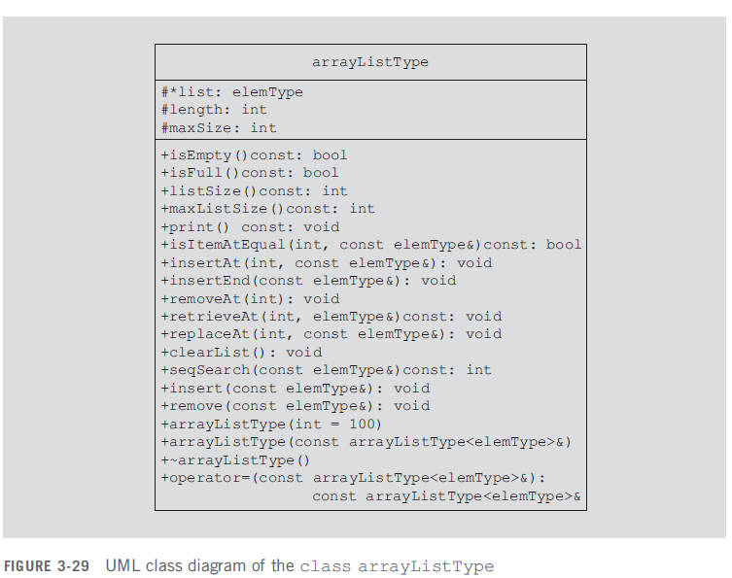

Slide 20
Function Definitions
The list is empty if length is zero; it is full if length is equal to maxSize. Therefore,
the definitions of the functions isEmpty and isFull are as follows:
template <class elemType>
bool arrayListType<elemType>::isEmpty() const
{
return (length == 0);
}
template <class elemType>
bool arrayListType<elemType>::isFull() const
{
return (length == maxSize);
}

Slide 21
Function Definitions
template <class elemType>
int arrayListType<elemType>::listSize() const
{
return length;
}
template <class elemType>
int arrayListType<elemType>::maxListSize() const
{
return maxSize;
}
Each of the functions isEmpty, isFull, listSize, and maxListSize contain only one statement, which is either a comparison statement or a statement returning a value. It follows that each of these functions is of O(1).

Slide 22
Function Definitions
template <class elemType>
void arrayListType<elemType>::print() const
{
for (int i = 0; i < length; i++)
cout << list[i] << " ";
cout << endl;
}
The function print uses a loop to output the elements of the list. The number of times the for loop executes depends on the number of elements of the list. If the list has 100 elements, the for loop executes 100 times. In general, suppose that the number of elements in the list is n. Then the function print is of O(n).

Slide 23
Function Definitions
template <class elemType>
bool arrayListType<elemType>::isItemAtEqual
(int location, const elemType& item) const
{
return(list[location] == item);
}
The body of function isItemAtEqual has only one statement, which is a comparison statement. It is easy to see that this function is of O(1).

Slide 24
Function Definitions
template <class elemType>
void arrayListType<elemType>::insertAt (int location, const elemType& insertItem)
{
if (location < 0 || location >= maxSize)
cerr <<"The position of the item to be inserted is out of range"<< endl;
else if (length >= maxSize) //list is full
cerr << "Cannot insert in a full list" << endl;
else
{
for (int i = length; i > location; i--)
list[i] = list[i - 1]; //move the elements down
list[location] = insertItem; //insert the item at the specified position
length++; //increment the length
}
} //end insertAt
The function insertAt uses a for loop to shift the elements of the list. The number of times the for loop executes depends on where in the list the item is to be inserted. If the item is to be inserted at the first position, all the elements of the list are shifted. It can be easily shown that this function is of O(n).

Slide 25
Function Definitions
template <class elemType>
void arrayListType<elemType>::insertEnd(const elemType& insertItem)
{
if (length >= maxSize) //the list is full
cerr << "Cannot insert in a full list" << endl;
else
{
list[length] = insertItem; //insert the item at the end
length++; //increment the length
}
} //end insertEnd
The number of statements and, hence, the number of operations executed in the body of the function insertEnd are fixed. Therefore, this function is of O(1).

Slide 26
Function Definitions
template <class elemType>
void arrayListType<elemType>::removeAt(int location)
{
if (location < 0 || location >= length)
cerr << "The location of the item to be removed "
<< "is out of range" << endl;
else
{
for (int i = location; i < length - 1; i++)
list[i] = list[i + 1];
length--;
}
} //end removeAt
Similar to the function insertAt, it is easily seen that the function removeAt is of O(n).

Slide 27
Function Definitions
template <class elemType>
void arrayListType<elemType>::retrieveAt
(int location, elemType& retItem) const
{
if (location < 0 || location >= length)
cerr << "The location of the item to be retrieved is "
<< "out of range." << endl;
else
retItem = list[location];
} //end retrieveAt
template <class elemType>
void arrayListType<elemType>::replaceAt
(int location, const elemType& repItem)
{
if (location < 0 || location >= length)
cerr << "The location of the item to be replaced is "
<< "out of range." << endl;
else
list[location] = repItem;
} //end replaceAt

Slide 28
Function Definitions
template <class elemType>
void arrayListType<elemType>::clearList()
{
length = 0;
} //end clearList

Slide 29
Constructor & Destructor
template <class elemType>
arrayListType<elemType>::arrayListType(int size)
{
if (size < 0)
{
cerr << "The array size must be positive. Creating "
<< "an array of size 100. " << endl;
maxSize = 100;
}
else
maxSize = size;
length = 0; list = new elemType[maxSize];
assert(list != NULL);
}
template <class elemType>
arrayListType<elemType>::~arrayListType()
{ delete[] list; }
As before, it is easy to see that each of the functions retrieveAt, replaceAt, clearList, as well as the constructor and destructor is of O(1).

Slide 30
Copy Constructor
template <class elemType>
arrayListType<elemType>::arrayListType
(const arrayListType<elemType>& otherList)
{
maxSize = otherList.maxSize;
length = otherList.length;
list = new elemType[maxSize]; //create the array
assert(list != NULL);
//terminate if unable to allocate memory space
for (int j = 0; j < length; j++) //copy otherList
list[j] = otherList.list[j];
} //end copy constructor

Slide 31
Overloading Assignment Operator
template <class elemType>
const arrayListType<elemType>& arrayListType<elemType>::operator=
(const arrayListType<elemType>& otherList)
{
if (this != &otherList) //avoid self-assignment
{
delete[] list;
maxSize = otherList.maxSize;
length = otherList.length;
list = new elemType[maxSize]; //create the array
assert(list != NULL); //if unable to allocate memory
//space, terminate the program
for (int i = 0; i < length; i++)
list[i] = otherList.list[i];
}
return *this;
}
//Similar to the function print, it is easy to see that both the copy constructor and the//function to overload the assignment operator are of O(n).

Slide 32

Search
Sequential or linear search
Search 27: Compare with list[0]→False→ list[1]→False→list[2]→True→Return index
Search 10: Compare with list[0]→False→ list[1]→False→…→list[6]→Return Item no found

Slide 33
Search Function
template <class elemType>
int arrayListType<elemType>::seqSearch(const elemType& item) const
{
int loc;
bool found = false;
for (loc = 0; loc < length; loc++)
if (list[loc] == item)
{
found = true;
break;
}
if (found)
return loc;
else
return -1;
} //end seqSearch
Chapter 9 explicitly shows that the function seqSearch is of O(n).

Slide 34
Insert Function
template <class elemType>
void arrayListType<elemType>::insert(const elemType& insertItem)
{
int loc;
if (length == 0) //list is empty
list[length++] = insertItem;
//insert the item and increment the length
else if (length == maxSize)
cerr << "Cannot insert in a full list." << endl;
else
{
loc = seqSearch(insertItem);
if (loc == -1) //the item to be inserted
//does not exist in the list
list[length++] = insertItem;
else
cerr << "the item to be inserted is already in "
<< "the list. No duplicates are allowed." << endl;
}
} //end insert // Due to seqSearch O(n)

Slide 35
Remove Function
template<class elemType>
void arrayListType<elemType>::remove(const elemType& removeItem)
{
int loc;
if (length == 0)
cerr << "Cannot delete from an empty list."
<< endl;
else
{
loc = seqSearch(removeItem);
if (loc != -1)
removeAt(loc);
else
cout << "The item to be deleted “
<< " is not in the list." << endl;
}
} //end remove
//Due to use of seqSearch and removeAt in sequence O(n)

Slide 36
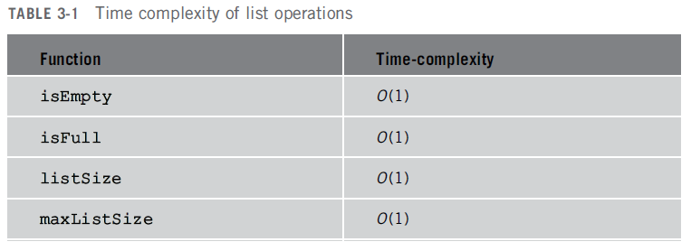
Time Complexities of List Operations

Slide 37
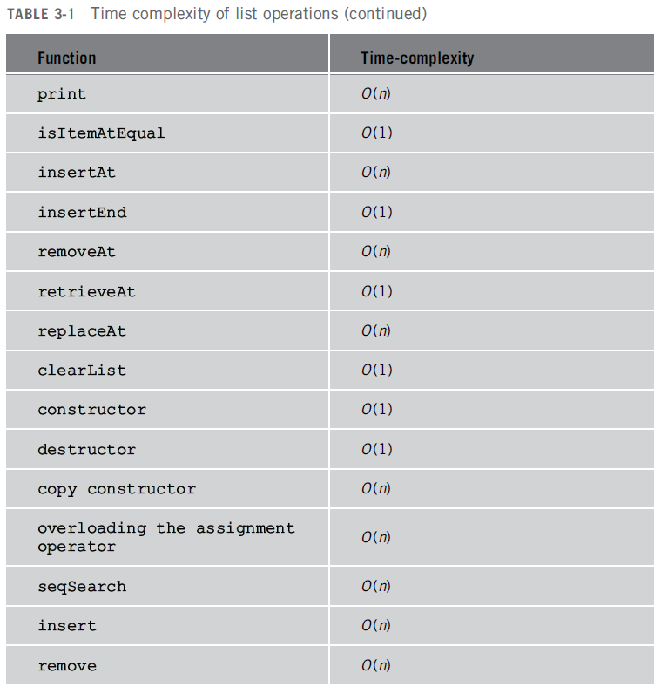
Time Complexities of List Operations

